Slide 1

COVID VACCINATION and EDUCATION IN THE UNITED STATES- Influenza Vaccine
AYOMIDE
AHMED
KEHLANI
MUSE

Slide 2


Agenda
States with most deaths
Relationship between death rates and Vaccination rates
Vaccination rates according to demography for each state

Slide 3


Introduction
Scenario:
The government wants to amplify the education around the need for covid vaccination to reduce the number of fatalities or severe cases in the US. They needs to know how to prioritize educative resources by demography. That is, they need to know what groups to focus on the most.
Research question:
This project aims to create a data visualization that the users (Government) can easily navigate through and derive their answers from.

Slide 4



DEATH RATES-
visualisation of states in the US and their death rates. Focusing on sates with the highest death rates

Slide 5
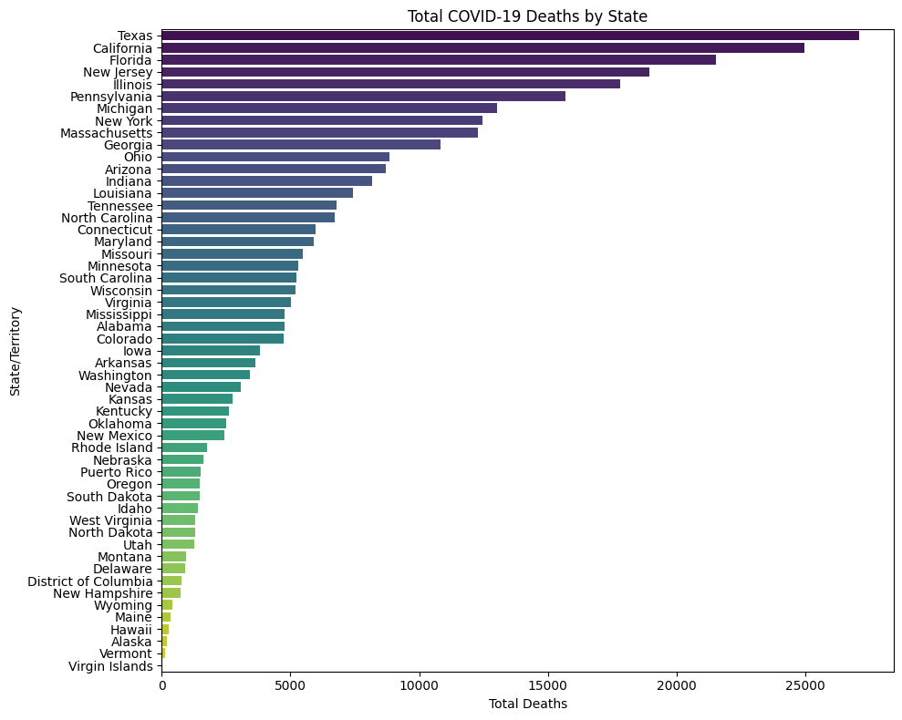

Slide 6
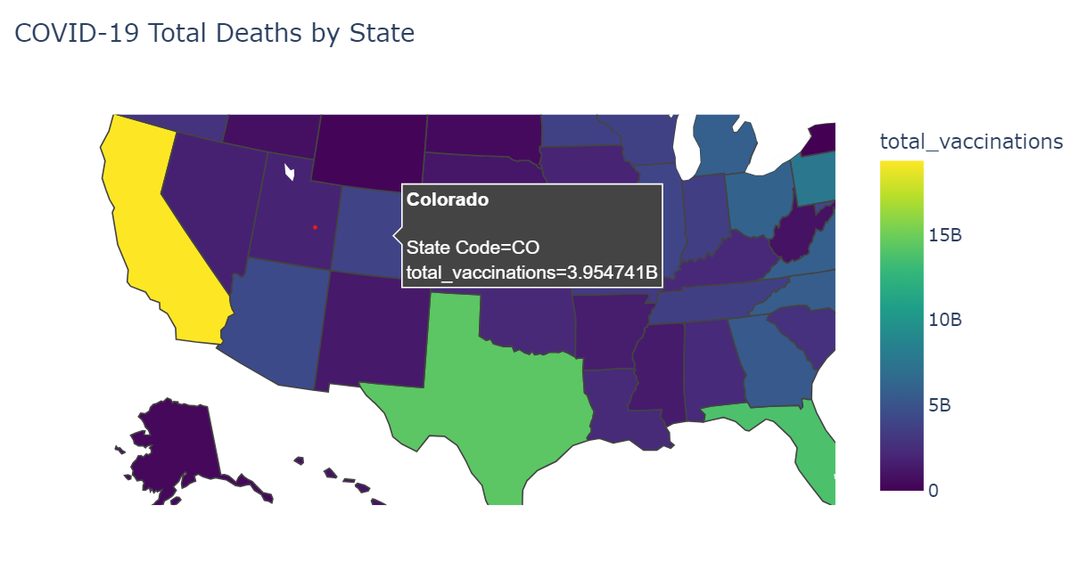

Slide 7

Relationship between death rates and Vaccination rates
So what do the vaccination rates look like in these states?

Slide 8
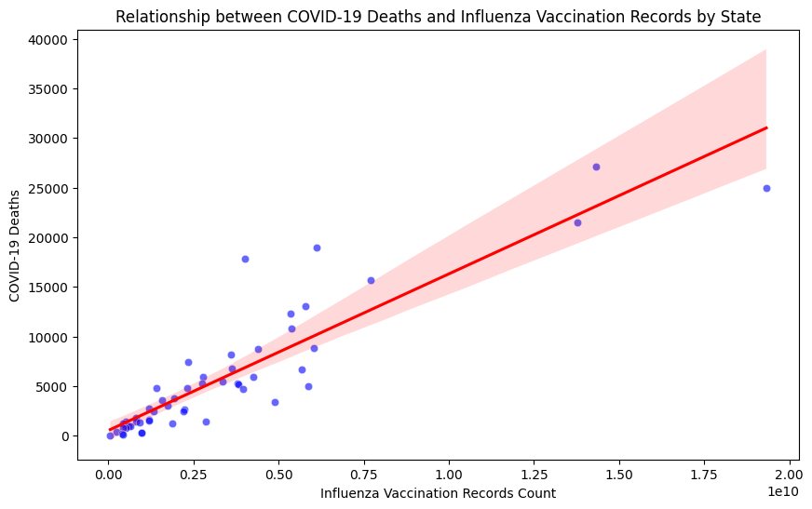

Slide 9
Vaccination rates according to demography for each state
Where do the government need to direct their awareness outreach to?

Slide 10
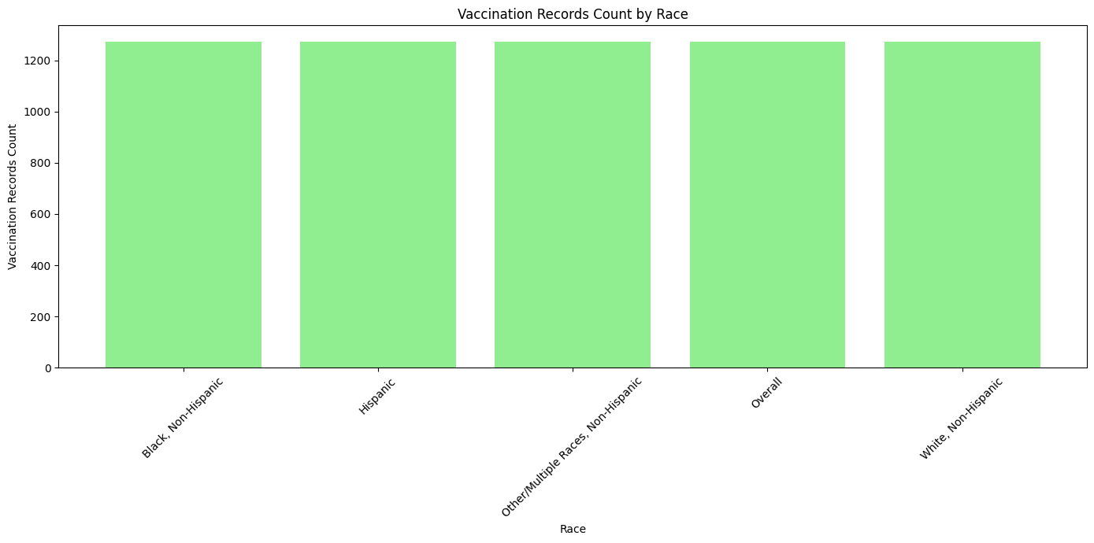
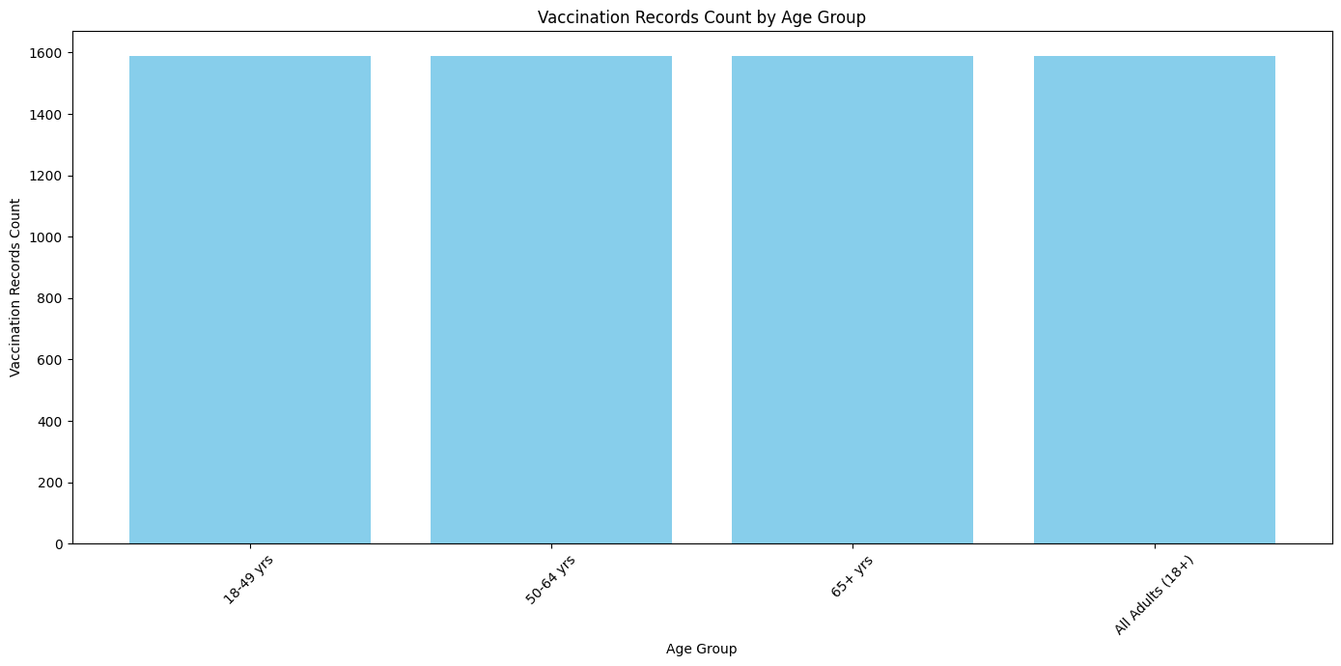

Slide 11




Summary
The top 3 high risk states, with the most deaths, are Texas California and Florida. Visualized on the map. Therefore, the government’s efforts will be focused on these states. The relationship with the demography of each state and the vaccination rate was however inconclusive.

Slide 12

Thank you

